Slide 1

WWW.SQLSCHOOL.COM
SQL BASICS
WWW.SQLSCHOOL.COM

Slide 2
DATABASE
Structured Query Language
SQL
TABLE
TABLE
TABLE
T-SQL
PL/SQL
MYSQL
SQL Server
ORACLE
MYSQL
DB
DB
DB
2016/2014/2012

Slide 3
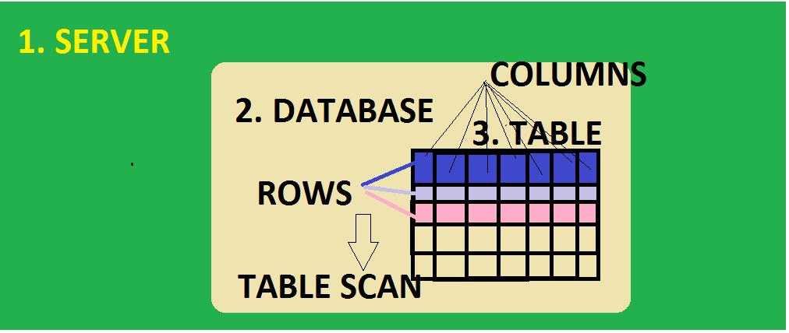

Slide 4
1
CREATE Database
Connect
CREATE Table
INSERT Data
SELECT
UPDATE Data
DROP Table
ALTER Table
DELETE Data
TRUNCATE
2
3
4
Data Definition Language
Data Manipulation Language
Notes:
Step 1: CREATE DATABASE
CONNECT TO DATABASE
Step 2: CREATE TABLE. THEN INSERT DATA (ROWS) INTO TABLE. Using “INSERT” Statement.
WE CAN “SELECT” / “RETREIVE” DATA INSERTED INTO ABOVE TABLE. Using “SELECT” Statement.
Step 3: OPTIONAL :
WE CAN MODIFY / CHANGE THE DATA INSERTED IN STEP 3 ABOVE. Using “UPDATE” Statement.
WE CAN ALSO DELETE / REMOVE DATA FROM THE TABLE. Using “DELETE” Statement.
Step 4: ADDITIONAL :
WE CAN CHANGE THE STRUCTURE OF ABOVE TABLE. Using “ALTER” Statement
WE CAN REMOVE / DROP THE TABLE STRUCTURE FROM ABOVE TABLE. Using “DROP” Statement.
Out of these, CREATE, ALTER and DROP are called DDL Statements. Data Definition Language Statements.
And INSERT, UPDATE and DELETE are called DML Statements. Data MANIPULATION Language Statements.
Kindly practice the same example explained in the class before you proceed with your own examples for practice.
Ensure you complete the tasks mentioned in this video class. Submit the same on our website.

Slide 5
SQL STATEMENTS
Data Definition Language (DDL)
CREATE : To define new objects
ALTER : To modify existing objects
DROP : To remove existing objects
Data Manipulation Language (DML)
INSERT : To insert / store new data
UPDATE : To modify existing table data
DELETE : To remove existing table data

Slide 6
INSERTING DATA
We can insert data using INSERT statement of T-SQL :
INSERT [INTO ] <table-name>
VALUES( <value-list>)
Value List signifies the Column values ( data).
Here, the INTO keyword is optional.
We can insert any number of rows into tables within our system storage limits.

